Slide 1
Samsung Innovation Campus

Slide 2
NLP Fake News Detection
Intellibots

Slide 3
NLP Fake News Detection
UNIT 1. About The Project
UNIT 4. Testing The Models
1.1. The Project Aims
4.1. KNN Model And Result
4.2. Random Forest Model And Result
4.3. Naive Bayes Model And Result
UNIT 2. About The Models
3.1. The Models
3.2. Model Training
3.3. Model Evaluation
3.4. Model Comparison
UNIT 5. Finalize
5.1. Best Model For Detecting
UNIT 3. Data Preprocessing
3.1. The Dataset 3.2. Text Pre-processing
Notes:
Note:

Slide 4

1.1. The Project Aims
UNIT 1. About The Project
Create a system that can detect fake news using NLP and machine learning. The system will analyze news articles, extract features, and classify messages as real or fake.
This project aims to detect fake news articles using Natural Language Processing (NLP) techniques and three different machine learning algorithms: Random Forest, K-Nearest Neighbors (KNN), and Naive Bayes.

Slide 5
2.1. The Models
UNIT 2. About The Models
The project implements three models for detecting fake news:
KNN
Random Forest
Naive Bayes
2.2. Model Training
The Random Forest, KNN, and Naive Bayes algorithms are trained on the feature vectors to create classifiers that can predict whether a news article is fake or real based on its text content.

Slide 6
2.3. Model Evaluation
UNIT 2. About The Models
The accuracy of the three classifiers is evaluated using cross-validation and performance metrics such as precision, recall, and F1 score.
2.4. Model Comparison
The performance of the three classifiers is compared to determine which algorithm performs best for fake news detection.

Slide 7
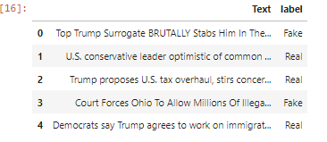
3.1. The Dataset
UNIT 3. Data Preprocessing
The dataset used for this project is a collection of news articles labeled as either fake or real, obtained from the Kaggle.
This data consists of two columns.
Text
label
Text is the statements or messages regarding a particular event/situation.
label feature tells whether the given Text is Fake or Real.

Slide 8
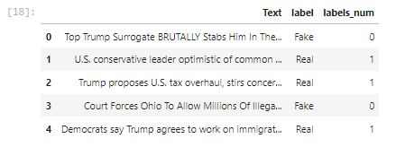

UNIT 3. Data Preprocessing
Check the distribution of labels
Adding a new column "label_num" which gives a unique number to each of these labels

Slide 9
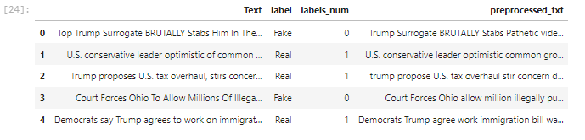
3.2. Text Pre-processing
UNIT 3. Data Preprocessing
Text pre-processing to remove stop words, punctuations and apply lemmatization by importing spacy library then create a new column "preprocessed_txt"

Slide 10
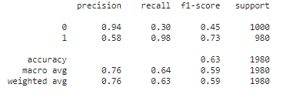
4.1. KNN Model And Result
UNIT 4. Testing The Models
Using the sklearn pipeline module create a classification pipeline to classify the Data.
Using CountVectorizer with unigram, bigram, and trigrams.
Use KNN as the classifier with n_neighbors of 10 and metric as ‘euclidean’ distance.

Slide 11
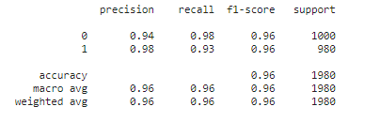
4.2. Random Forest Model And Result
UNIT 4. Testing The Models
Using the sklearn pipeline module create a classification pipeline to classify the Data.
Using CountVectorizer with only trigrams.
Use RandomForest as the classifier.

Slide 12
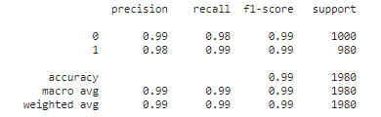
4.3. Naive Bayes Model And Result
UNIT 4. Testing The Models
Using the sklearn pipeline module create a classification pipeline to classify the Data.
Using CountVectorizer with both unigram and bigrams.
Use Multinomial Naive Bayes as the classifier with an alpha value of 0.75.

Slide 13
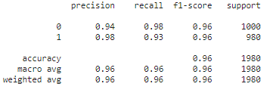
5.1. Best Model For Detecting
UNIT 5. Finalize
Multinomial Naive Bayes
KNN
Random Forest
Multinomial Naive Bayes

